Slide 1

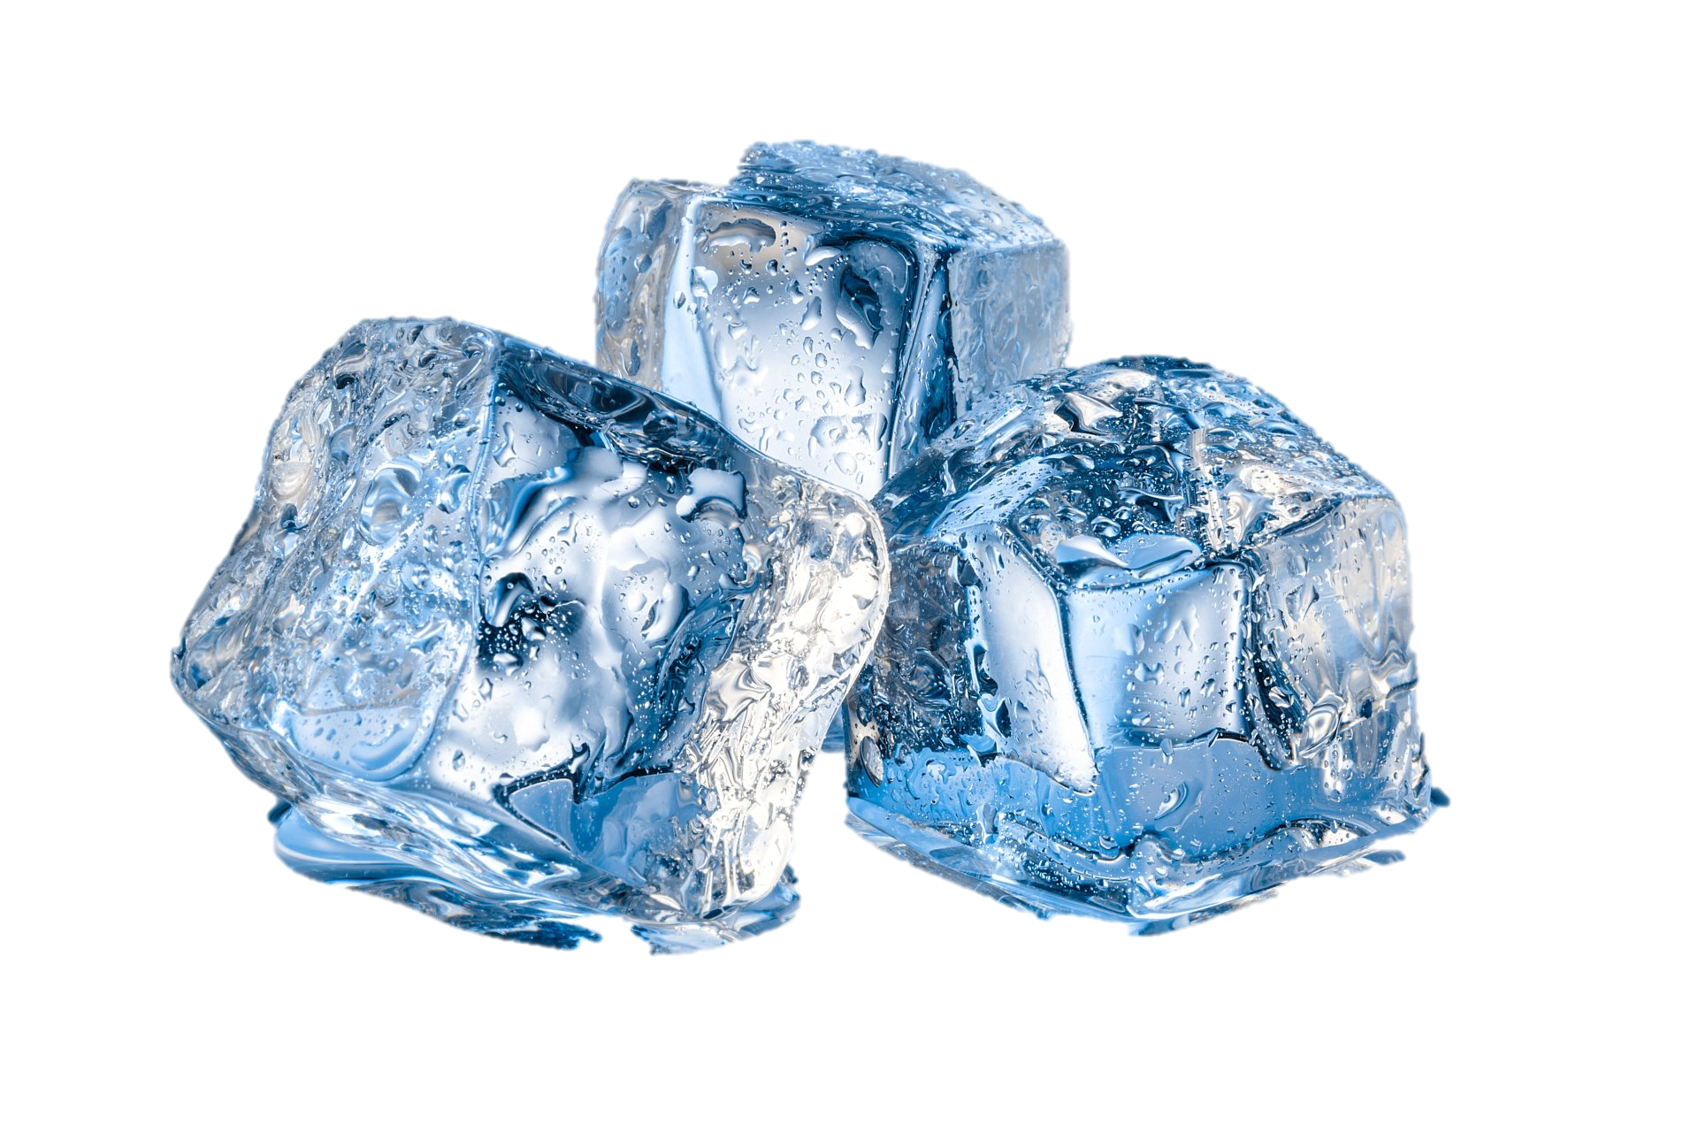
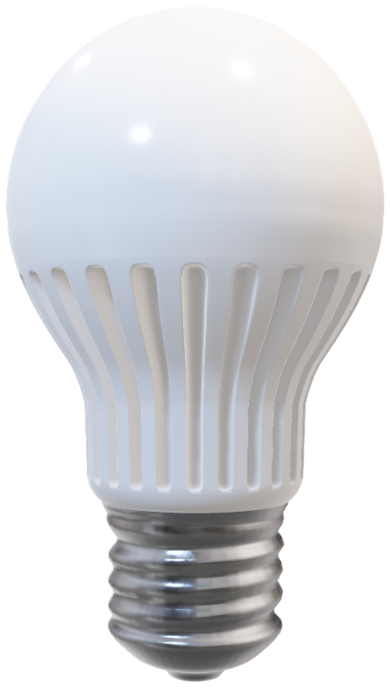

Slide 2
Room temperature turns the light bulb green/neutral colour

Slide 3
Cold turns the light bulb blue

Slide 4
Heat turns the light bulb red

